Slide 1

Checking understanding of similarity
Task A: Checking understanding of enlargement
1) a) Enlarge the object by a scale factor of 3 from the point marked.
Check: the bottom left vertex of the image should be directly below the bottom right vertex of the object.
b) Use a ruler to measure all of the lengths on each shape and check that each length on the image is 3 times its corresponding length on the object.
Lengths may vary depending on printing.
Example of a combination of lengths:
Check:
15 ÷ 5 = 3
12 ÷ 4 = 3
9 ÷ 3 = 3
15 cm
9 cm
5 cm
3 cm
4 cm
12 cm

Slide 2
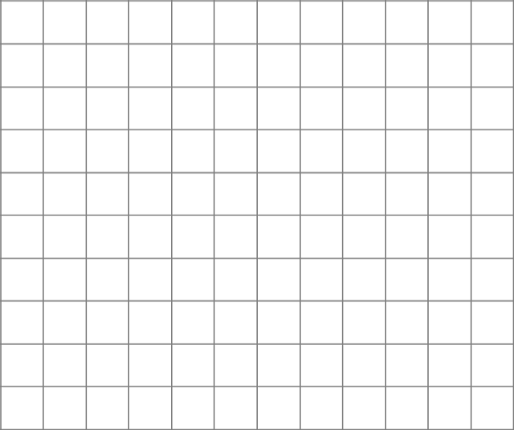
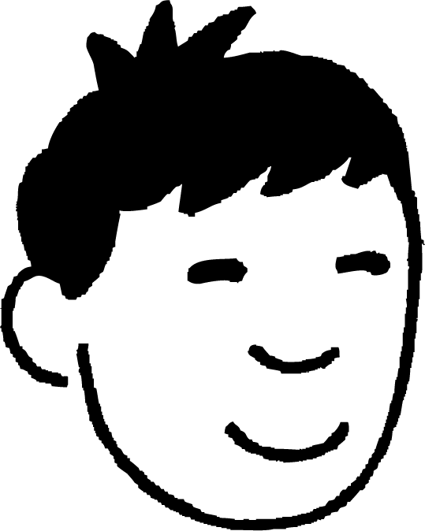
Checking understanding of similarity
c) Use a protractor to measure all of the angles on each shape and check that each angle on the image is equal to its corresponding angle on the object.
If worksheet has been printed in proportion, angles should match those below.
Angles may vary if the proportions have not been maintained.
Check:
53°
Angles in the image are equal to their corresponding angles in the object.
15 cm
9 cm
5 cm
53°
3 cm
37°
Additional check:
4 cm
53 + 90 + 37 = 180 Angles in each triangle sum to 180°.
37°
12 cm
2) Jun wants to enlarge the shape by a scale factor of 2. He needs to choose the centre of enlargement carefully so that all of the image stays on the grid.
Find all the points which Jun could use for the centre of enlargement.
The image stays on the grid when using any centre of enlargement in this region.

Slide 3
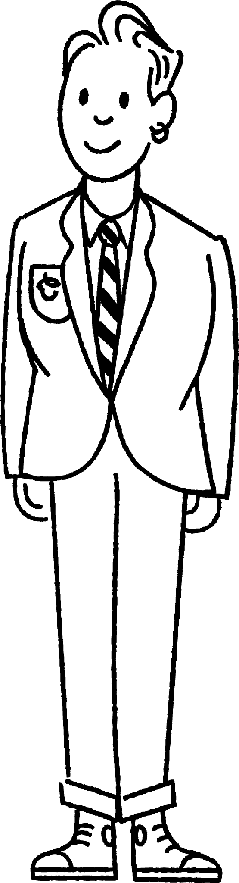



Checking understanding of similarity
Task B: Checking understanding of similarity
1) Use similarity to find the missing lengths.
a)
b)
70 inches
140 inches
6.1 m
148 cm
370 cm
15.25 m
35 inches
2) a) Match each triangle with its similar triangle. b) Find the scale factor between each pair of similar triangles.
29
10
5
12.5
7.5
D
10.5
A
12
B
C
14.5
13
20
21
10
34
5
3
G
39
F
4
15
E
16
30
15
8
H
36
17
A and E
scale factor 3 or
B and D
scale factor 2 or
C and G
scale factor or
F and H
scale factor 2 or
Mathematics in Education and Industry
v2.3

